Slide 2
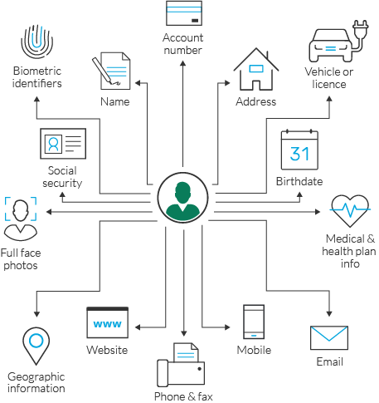
Introduction to Multilingual PII Detection and Anonymization
Importance of PII Detection and Anonymization
Personal Identifiable Information (PII) detection and anonymization is crucial in managing sensitive data, particularly in Request for Proposal (RFP) documents. The increasing reliance on digital documentation necessitates robust systems to protect sensitive information from unauthorized access.
Objectives of the System
Detect and anonymize PII in various document formats. Ensure compliance with data protection regulations. Enhance data security and privacy for organizations handling sensitive data.

Slide 3
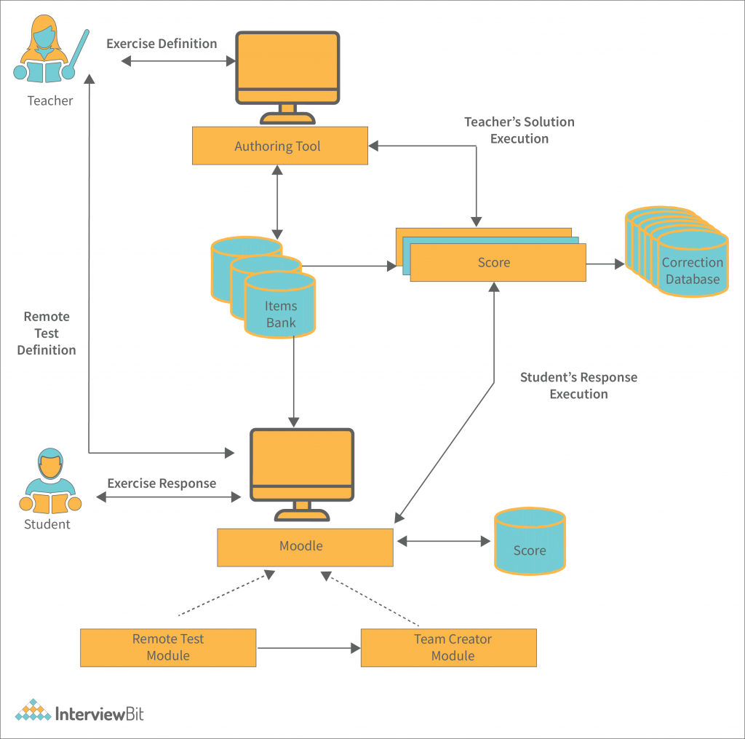
Architecture Overview of the System
System Architecture Flow: The architecture of the Multilingual PII Detection and Anonymization System includes several key stages:
Input Text: RFP documents and various text formats are received.
Preprocessing: Raw text undergoes normalization and cleaning.
Detection Engines: PII detection is performed using multiple engines.
Validation Layer: Extracted entities are validated for accuracy.
Entity Aggregation: Entities are aggregated for analysis.
Anonymization Layer: PII is masked or replaced.
Risk Assessment: Documents are categorized based on detected PII.
Output: Final deliverables are generated, including anonymized text and risk scores.
Significance of Each Stage: Each stage of the pipeline plays a critical role in ensuring the effectiveness and reliability of the system in managing sensitive data.

Slide 4

Input Text Sources
Types of Input Documents: The system is designed to process various text formats, with a primary focus on RFP documents. These documents may include:
Word documents
PDFs
Plain text files
HTML formatted texts
Importance of Diverse Input Handling: Handling multiple document formats ensures comprehensive coverage and flexibility in processing various types of sensitive information.

Slide 5
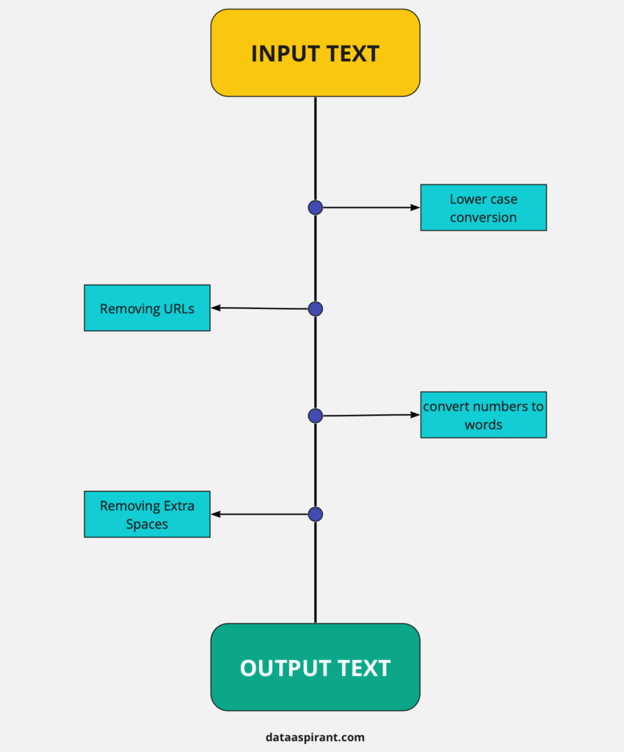
Preprocessing Stage
Techniques Applied: The preprocessing stage involves several techniques to prepare raw text for further analysis:
Text Normalization: Standardizing text formats, such as converting to lowercase and removing special characters.
Cleaning Processes: Eliminating irrelevant information and ensuring that the text is free from noise.
Goals of Preprocessing: - Enhance the quality of the input data.
Improve the accuracy of subsequent detection processes.

Slide 6
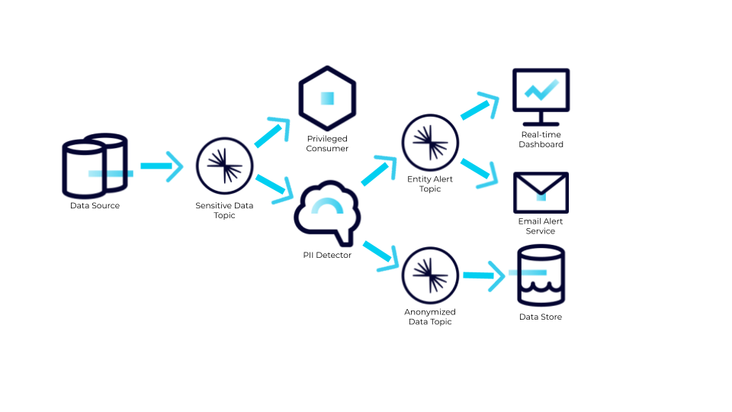
Detection Engines Overview
Various Detection Engines: The system employs multiple detection engines to identify PII effectively. These engines include:
Presidio Analyzer: A powerful tool for detecting various types of PII.
Hugging Face Transformers: Utilized for Named Entity Recognition (NER) in Arabic.
spaCy NER Models: Specifically designed for English and French PII detection.
Regex Patterns: Custom patterns for identifying specific PII types.
Roles in PII Detection: Each detection engine has a unique role, ensuring comprehensive coverage of different PII types across multiple languages.

Slide 7
Presidio Analyzer and Custom Recognizers
In-Depth Look at Presidio Analyzer: The Presidio Analyzer is a cornerstone of the system, equipped with custom recognizers for various PII types:
Financial Data: Credit card numbers, bank account details.
Addresses: Street addresses in English, French, and Arabic.
Emails: Detection of email addresses across languages.
Cryptographic Data: Identifying crypto wallet addresses.
Phone Numbers and Names: Recognizing personal names and phone numbers.
Multilingual Support: The custom recognizers are designed to work effectively across English, French, and Arabic, ensuring robust detection capabilities.

Slide 8
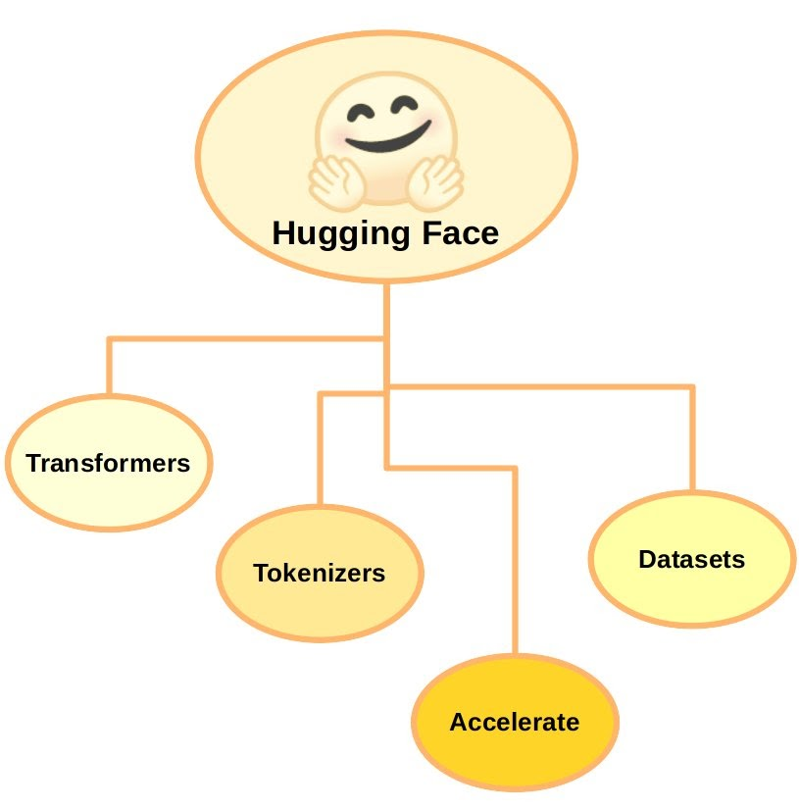
Hugging Face Transformers for Arabic NER
Utilization of Hugging Face Transformers: Hugging Face Transformers are leveraged for Named Entity Recognition (NER) specifically in Arabic, providing advanced capabilities in detecting PII.
Effectiveness Compared to Traditional Approaches:
Contextual Understanding: Transformers provide better contextual understanding of text, improving recognition rates.
Adaptability: Models can be fine-tuned based on specific datasets, enhancing performance.
Impact on Arabic PII Detection: The use of Transformers significantly enhances the system's ability to accurately detect PII in Arabic texts, which is traditionally more challenging.

Slide 9

spaCy NER Models for English and French
Application of spaCy’s NER Models: spaCy’s NER models are employed to detect PII in both English and French texts.
Model Training and Customization:
Training on Domain-Specific Data: Models are trained on datasets relevant to RFP documents.
Customization Options: Users can customize models to improve detection accuracy for specific PII types.
Benefits of Using spaCy:
High accuracy in PII detection.
Efficient processing of large text volumes.
Support for multilingual applications.

Slide 10
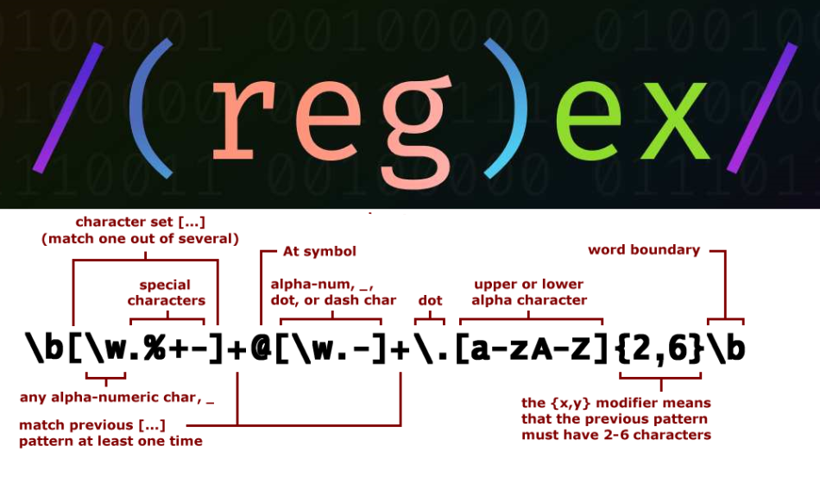
Regex Patterns for PII Detection
Summary of Regex Patterns: Regular expressions (Regex) are utilized for detecting various types of PII, including:
Emails: Standard patterns for email address detection.
IBANs: Patterns to identify International Bank Account Numbers.
SSNs: Detection of Social Security Numbers.
Credit Cards: Identifying credit card formats.
Phone Numbers: Patterns for various international phone formats.
Addresses: Specific patterns for Arabic and French addresses.
Importance of Regex in PII Detection: Regex patterns provide a reliable method for identifying structured PII types, complementing machine learning approaches.

Slide 11
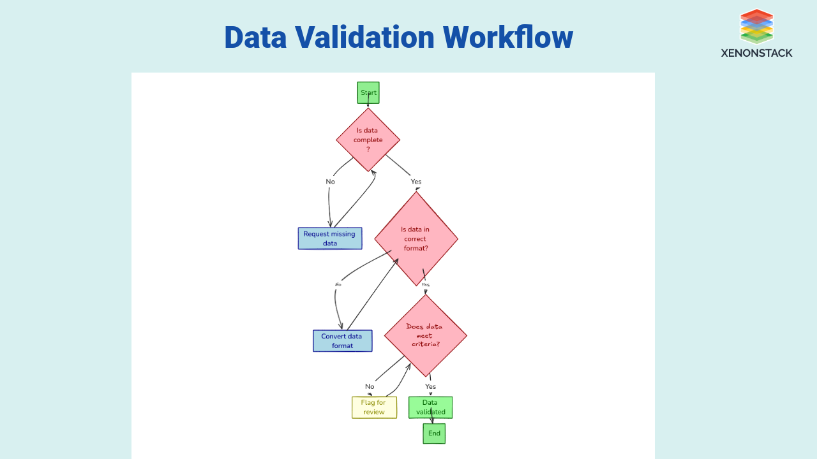
Validation Layer: Ensuring Accuracy
Validation Methods: The validation layer employs specialized methods to ensure the accuracy of extracted entities, focusing on:
IBAN Validation: Checking the validity of extracted IBANs against established formats.
VAT Numbers: Validation to ensure compliance with tax regulations.
Credit Card Validation: Using Luhn's algorithm to verify credit card numbers.
Crypto Wallets: Ensuring the integrity of extracted cryptocurrency addresses.
Importance of Validation: Validation is crucial for maintaining the reliability of the system and ensuring that sensitive data is accurately identified and processed.

Slide 12
Entity Aggregation Process
The entity aggregation process involves collecting and organizing detected PII entities for further analysis. This step is crucial for ensuring that all relevant information is gathered systematically, allowing for a comprehensive review of the data.
A key aspect of this process is managing duplicates and context preservation. Duplicate management ensures that duplicate entities are identified and handled appropriately, while context preservation maintains the context of detected entities to facilitate better understanding during anonymization.
The benefits of aggregation include streamlined analysis of detected PII and enhanced clarity in risk assessment and reporting. By organizing entities effectively, organizations can improve their ability to assess risks and make informed decisions regarding data handling.

Slide 13
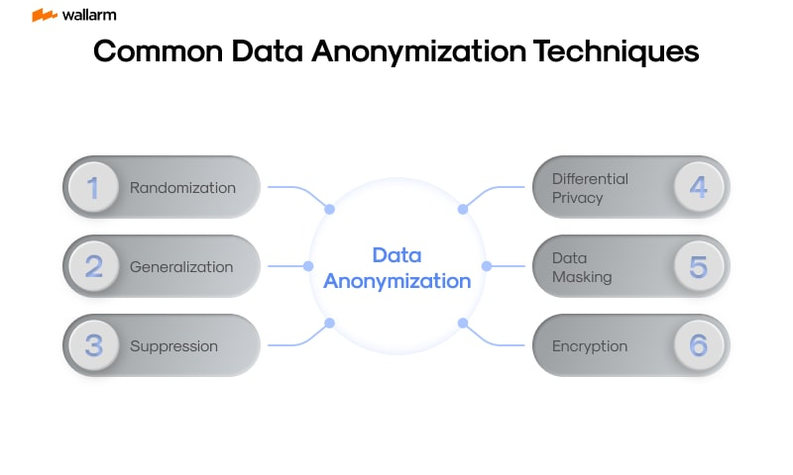
Anonymization Layer Mechanism
Techniques Used for Anonymization: The anonymization layer employs various techniques to mask or replace PII entities based on their type:
Masking: Replacing PII with generic placeholders (e.g., "[EMAIL]").
Replacement: Substituting PII with non-sensitive equivalents.
Types of PII Entities Anonymized:
Emails: Replaced with generic labels.
Credit Cards: Masked to show only the last four digits.
Social Security Numbers: Fully masked or replaced.
Importance of Anonymization: Anonymization protects sensitive data while ensuring that the information remains usable for analysis and reporting.

Slide 14
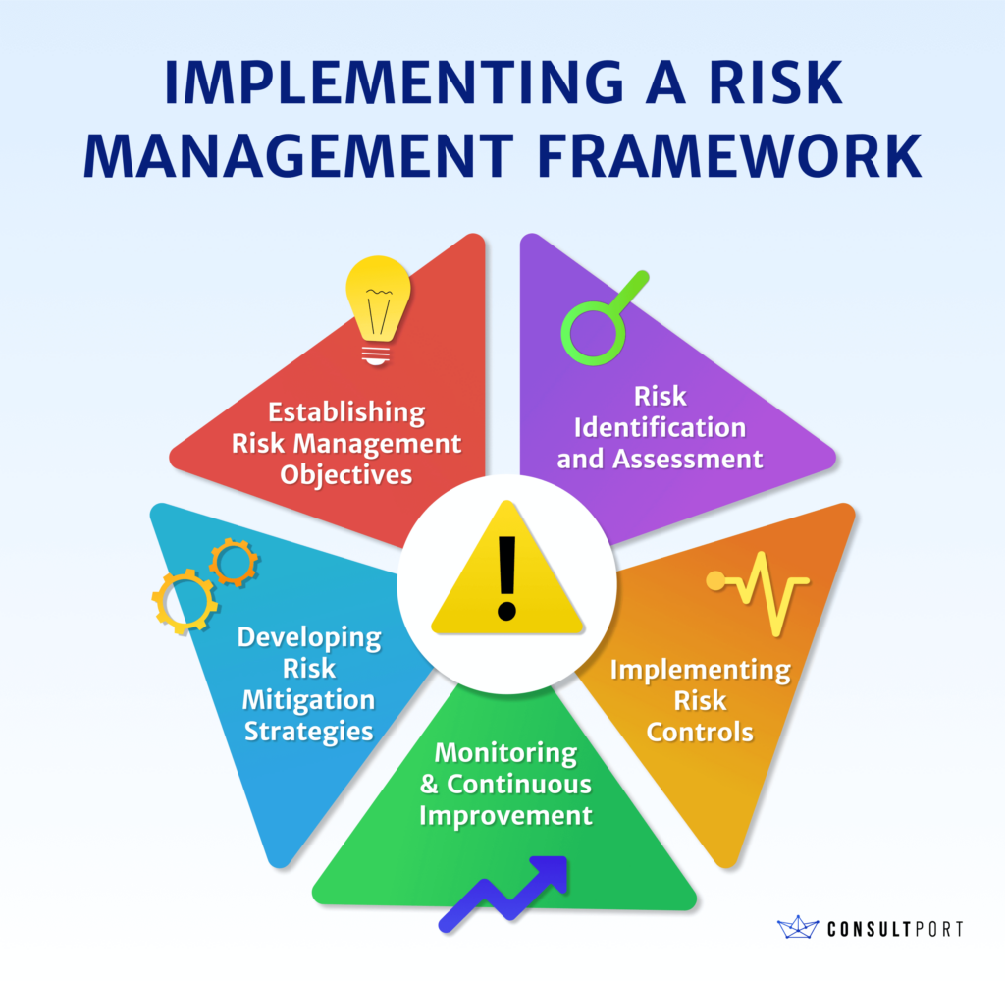
Risk Assessment Methodology
Categorizing Documents by Risk Levels: The risk assessment process categorizes documents into three risk levels based on the quantity and types of detected PII:
LOW Risk: Minimal PII detected.
MEDIUM Risk: Moderate amounts of sensitive information.
HIGH Risk: Significant quantities of PII requiring immediate action.
Importance of Risk Assessment: Risk assessment helps organizations prioritize their responses and implement appropriate data protection measures.

Slide 15
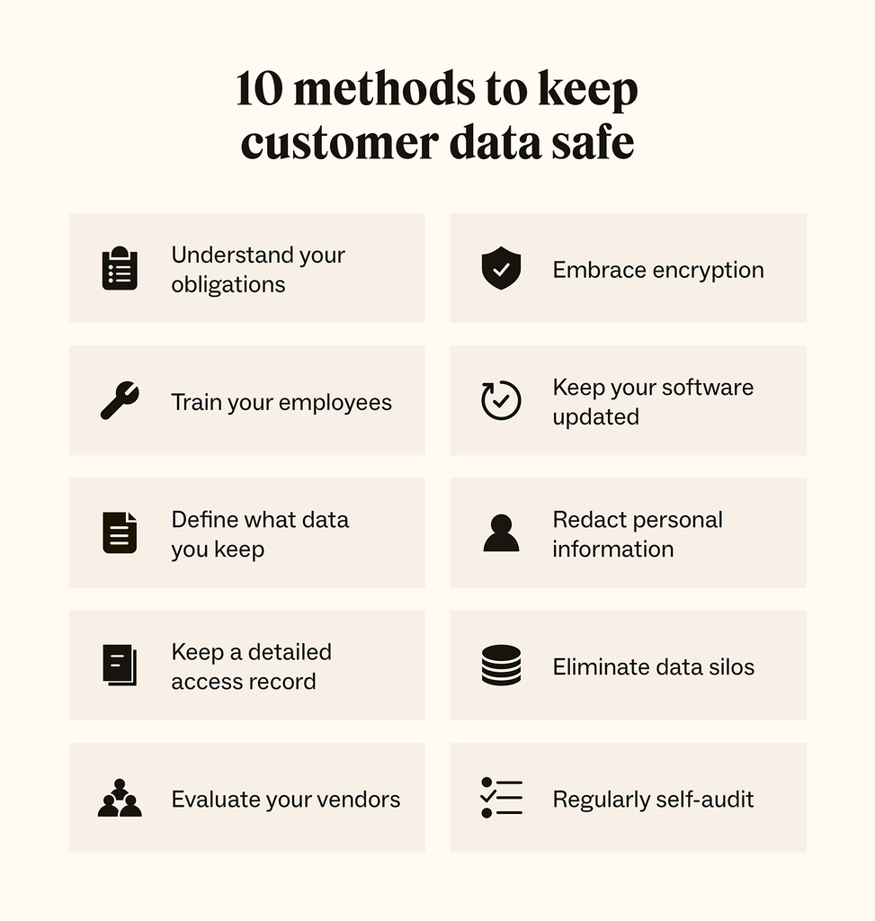
Generating Recommendations for Risk Management
Actionable Recommendations: The system generates actionable recommendations based on the assessed risk level:
LOW Risk: Routine monitoring of documents.
MEDIUM Risk: Consider additional encryption measures.
HIGH Risk: Immediate removal of sensitive fields and enhanced security protocols.
Benefits of Recommendations: Providing tailored recommendations empowers organizations to take proactive steps in managing sensitive data.

Slide 16
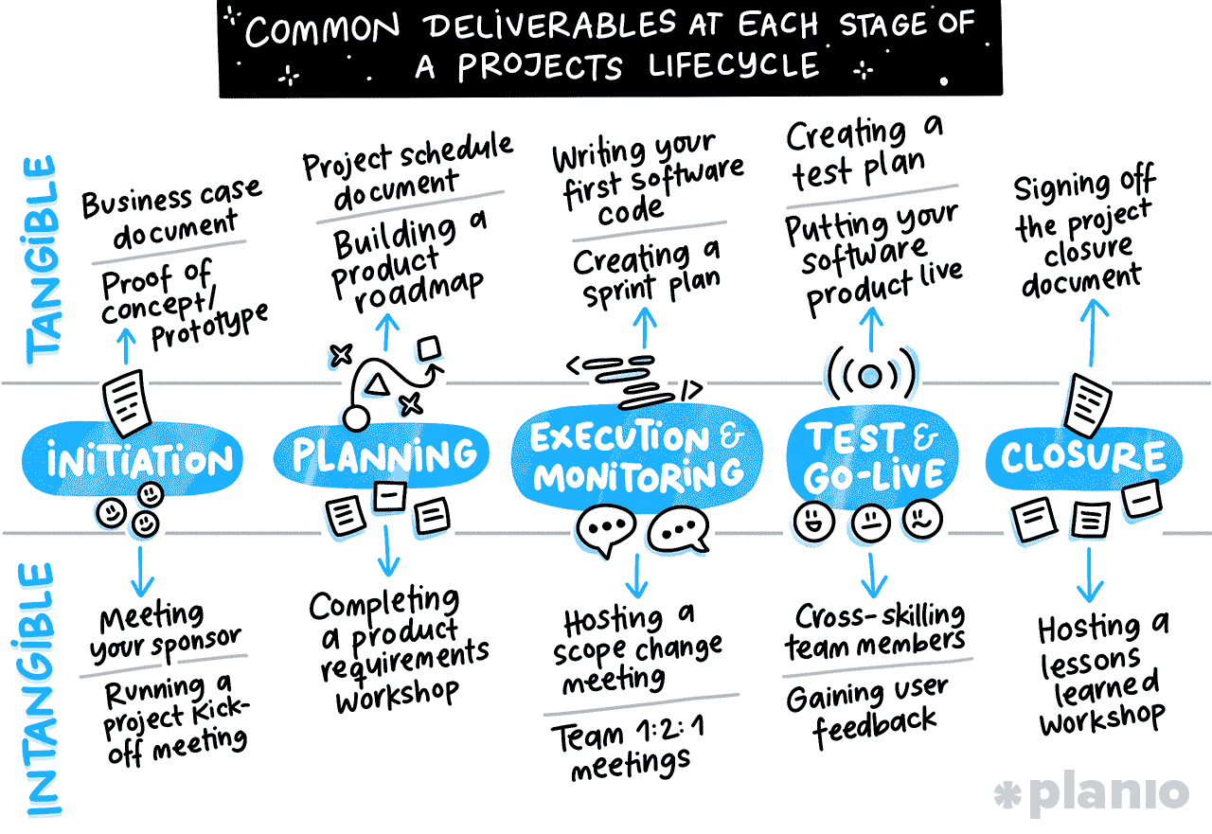
Output Deliverables
Presentation of Output: The system provides several output deliverables, including:
Anonymized Text: Original text with PII masked or replaced.
Detected Entity Metadata: Detailed information about detected PII entities.
PII Type Breakdown: Overview of the types of PII identified.
Overall Risk Score: A summary score indicating the document's risk level.
Importance of Output Deliverables: Output deliverables facilitate informed decision-making and enhance compliance with data protection regulations.

Slide 17
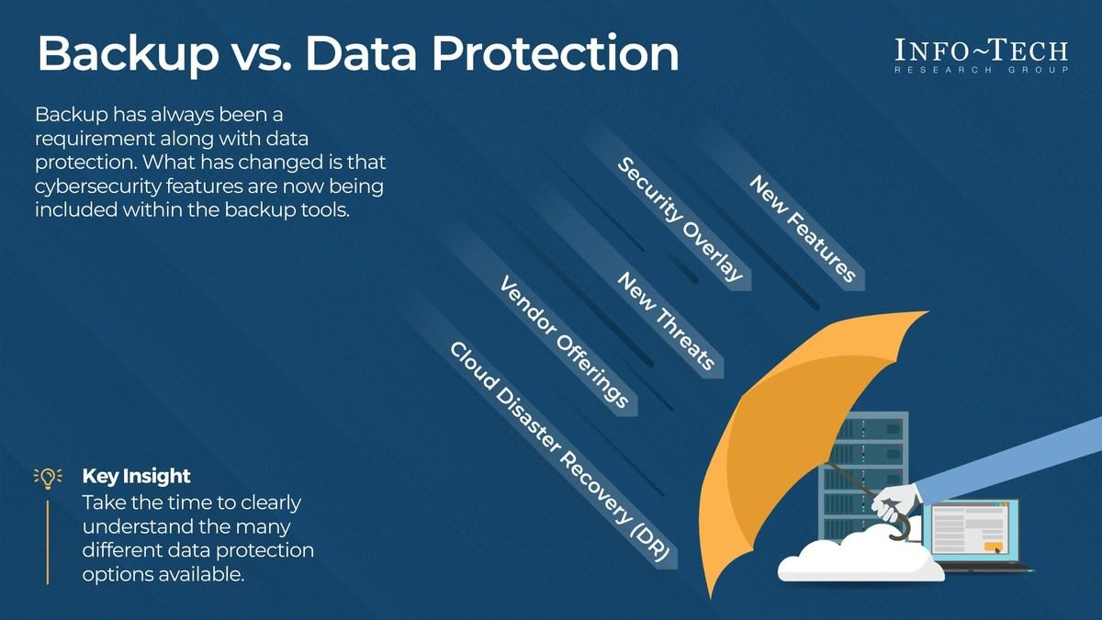
Technical Highlights of the System
Key Technical Features:
Multi-Language Support: The system supports English, French, and Arabic, ensuring broad applicability.
Robust Detection Capabilities: Combines machine learning (Transformers, spaCy) and rule-based techniques (Regex, Presidio) for enhanced accuracy.
Benefits of Technical Features:
Provides comprehensive coverage across languages and PII types.
Optimizes detection processes for efficiency and reliability.

Slide 18

Machine Learning and Rule-Based Integration
Combination of Techniques: The integration of machine learning techniques with rule-based approaches enhances detection accuracy:
Transformers and spaCy: Leverage advanced NLP capabilities for effective PII detection.
Regex and Presidio: Provide reliable identification of structured PII types.
Benefits of Integration: This hybrid approach ensures that the system can effectively handle diverse PII detection challenges in multilingual contexts.

Slide 19
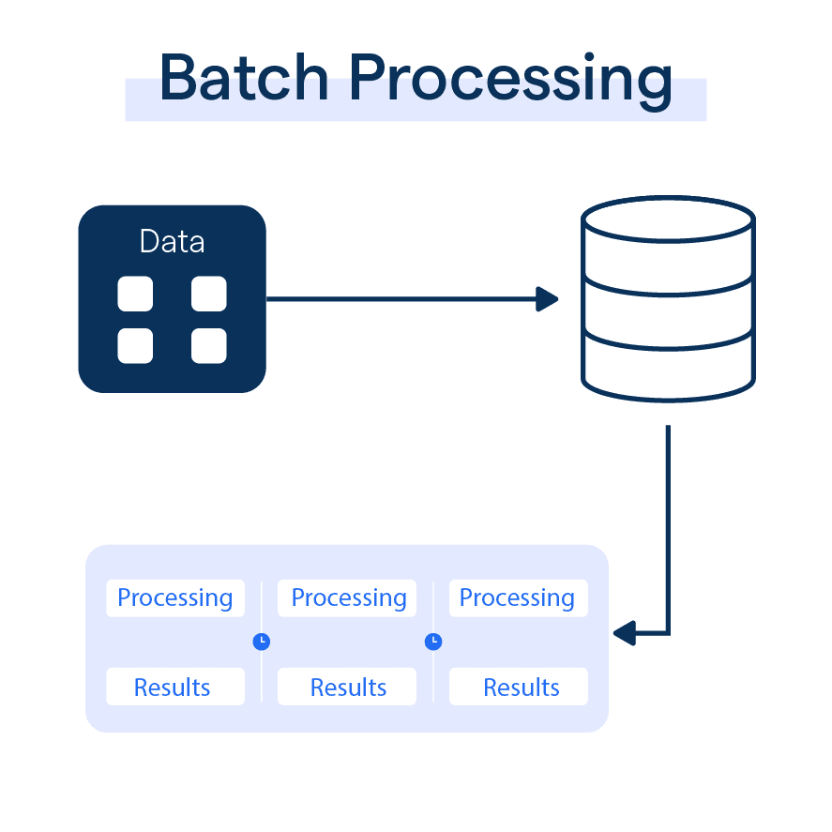
Batch Processing and Error Handling
Batch Processing Capabilities: The system is designed to process multiple RFP documents simultaneously, enhancing efficiency.
Error Handling Mechanisms:
Error Logging: Captures and logs errors encountered during processing.
Recovery Protocols: Ensures that processing can continue smoothly after errors are addressed.
Importance of Batch Processing: Batch processing and effective error handling significantly improve the system's usability and reliability in real-world applications.

Slide 20
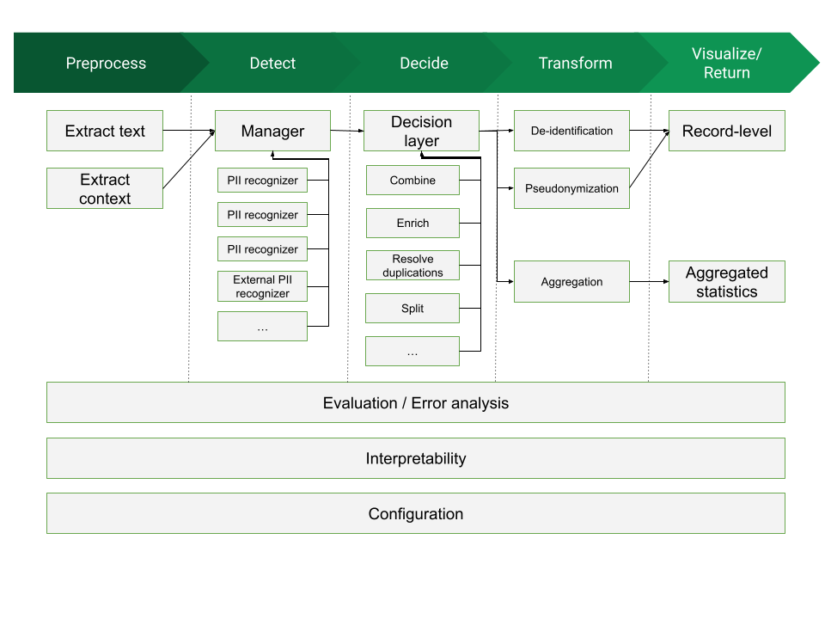
Conclusion and Future Directions
Summary of System Capabilities: The Multilingual PII Detection and Anonymization System offers robust capabilities for managing sensitive data in RFP documents, combining advanced detection techniques with effective anonymization processes.
Potential Future Enhancements:
Integration of additional languages and PII types.
Enhanced machine learning models for improved accuracy.
Continued development of user-friendly interfaces for better accessibility.

Slide 21

Appendix: Additional Resources and References
Compilation of Resources:
Documentation: Comprehensive guides on system usage and features.
Research Papers: Studies on PII detection methodologies and best practices.
Online Resources: Links to relevant tools and libraries used in the system.
Importance of Additional Resources: Providing access to additional resources empowers users to further explore the field of multilingual PII detection and anonymization systems.

